Slide 1
Introduction to the 2017 Version of
Land Trust Standards and Practices

Slide 2
Introduction to the Revised Standards
Notes:
NOTES: Land Trust Standards and Practices have been revised before – most recently in 2004. It’s necessary to periodically revise the Standards because practices change, new issues and challenges develop and problems are resolved (or no longer major threats).
Goals of the Revisions Process:
Engage all land trusts with work of pursuing excellence and continuous improvement
Make the Standards accessible for entire land trust community
Update to reflect changes in legal and operational environment
Ensure alignment with accreditation, Terrafirma and other resources and tools
Revisions Process
About 1,600 individual comments from more than 450 different stakeholders
Vast majority loved the new format
Some general concerns
Philosophical disagreements
More written policies and procedures
Some confusion about accreditation
Comments underscore importance for good background materials
Results of Revisions Process
Vast majority loved the new format
Some general concerns
Philosophical disagreements
More written policies and procedures
Comments underscore importance for good background materials, some of which is posted on The Learning Centre and rest is forthcoming.
Retained 12-standard framework
More readable and streamlined document
Focuses on practices that apply broadly to land trust community
Improves clarity, reduce redundancy
Organizes the practices into elements
Designed as online resource
Clearly highlights those items that lead to accreditation
Links to Alliance resources, narratives and requirements
They are designed as guiding principles for all land trusts.

Slide 3
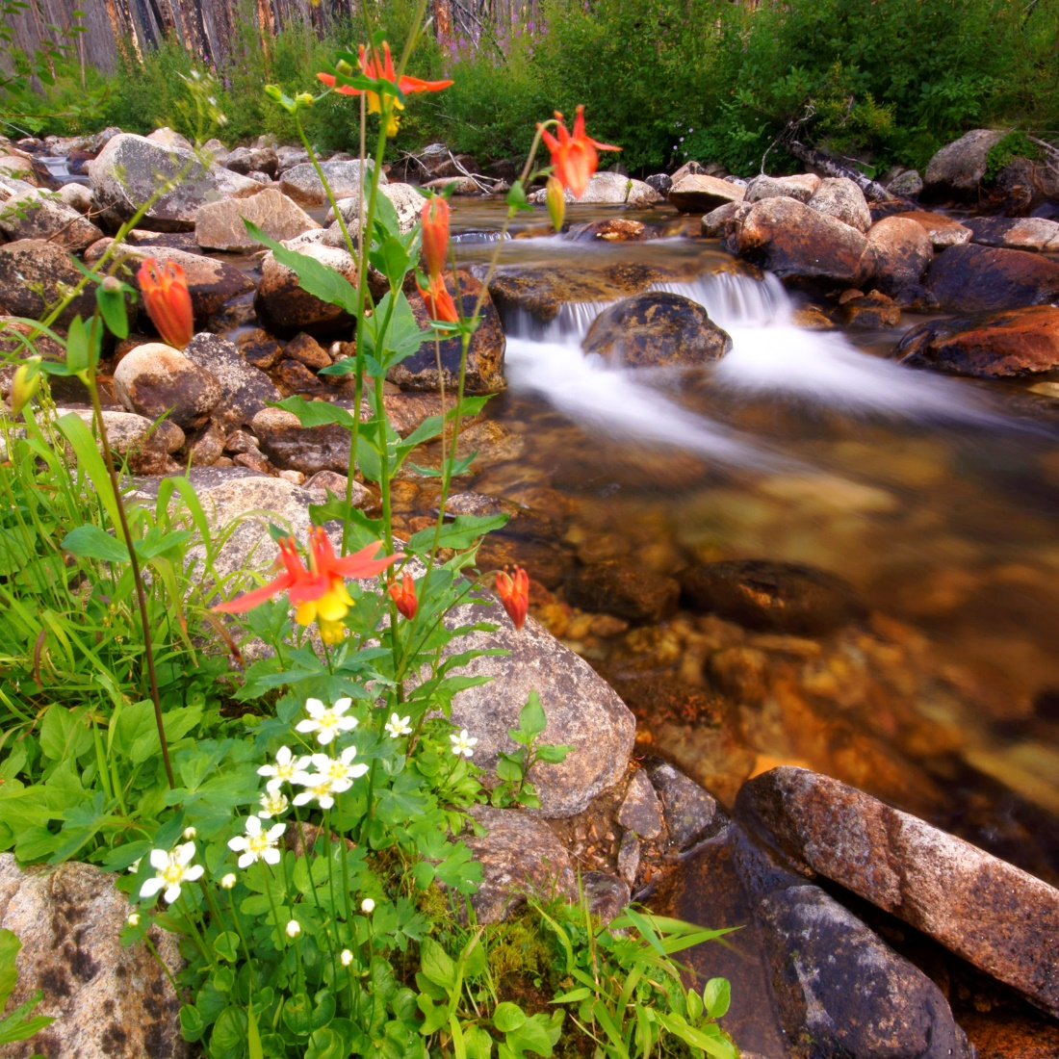
2017 Standards: What’s New
2017 Standards: What’s New

Slide 4
Standard 1: Ethics, Mission and Community Engagement
Notes:
Practice 1A. Ethics now asks land trusts to adopt a written code of ethics and/or values statement and a whistleblower policy, and affirms that land trusts should not participate in transactions that are potentially fraudulent or abusive.
•Practice 1C. Community Engagement contains four new elements that reflect the importance of (1) developing an inclusive and welcoming organizational culture, (2) fostering opportunities to connect people with the land, (3) developing an understanding of the land trust’s community to facilitate authentic communications and engagement and (4) building relationships with community leaders.

Slide 5
Standard 2: Compliance with Laws

Slide 6
Standard 3: Board Accountability
Notes:
Practice 3A. Board Responsibility strengthens the board’s duty to provide oversight of the land trust’s finances and operations by, among other things, working to ensure that sufficient financial resources are available and reviewing the financial audit.
Practice 3B. Board Composition and Structure follows the Independent Sector’s recommendations of having a board substantially composed of independent members, ensuring the board’s presiding officer and treasurer are not the same individual and clarifying that no staff member should serve as the board’s president officer or treasurer.

Slide 7
Standard 4: Conflicts of Interest
Notes:
Practice 4B. Payments to Board Members clarifies what land trusts need to do in the limited circumstances when they compensate a board member for professional services and prohibits land trusts from providing loans to directors, officers or trustees.

Slide 8
Standard 5: Fundraising
Notes:
Practice 5B. Accountability to Donors adds a requirement for a written policy or procedure to ensure land trusts honor donor privacy concerns.
Practice 5C. Fundraising Plan asks land trusts to develop and implement a fundraising plan or program.

Slide 9
Standard 6: Financial Oversight
Notes:
Practice 6A. Fiscal Health includes three new elements asking land trusts to (1) address deficit-spending trends, (2) assess revenues and diversify funding sources and (3) build and maintain operating reserves.

Slide 10
Standard 7: Human Resources
Notes:
Practice 7D. Transition Planning requires land trusts to develop a process or plan to provide for continuity in the leadership and management of the land trust’s functions.

Slide 11
Standard 8
Notes:
Generally no major changes to this practice. To meet best practices, land trusts must still create a baseline for all conservation easements, conduct title work, etc. (FILL IN)

Slide 12
Standard 9: Ensuring Sound Transactions
Notes:
Practice 9C. Environmental Due Diligence clarifies that a land trust should conduct or obtain a preliminary environment investigation for every land and conservation easement transaction.
• Practice 9F. Title Investigation and Recording makes clear that a land trust should use a title company or attorney to investigate title and that the title should be updated at or just prior to closing.

Slide 13
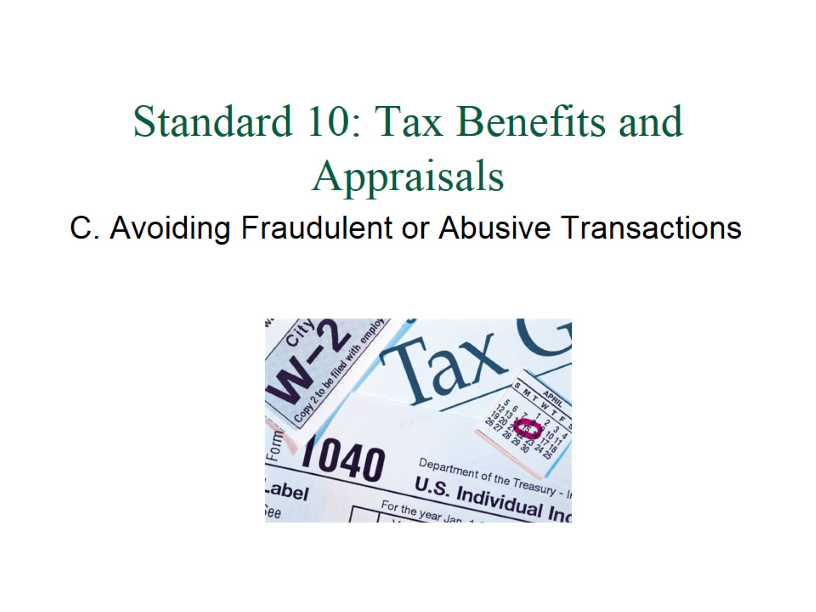
Standard 10: Tax Benefits and Appraisals
Notes:
Practice 10C. Avoiding Fraudulent or Abusive Transactions explicitly asks land trusts to discuss substantial concerns about the appraisal, the appraised value or other terms of the transaction with legal counsel and take appropriate action. It also requires land trusts to use a high level of due diligence in evaluating projects with pass-through entities of unrelated parties and to decline to participate in certain of these transactions.

Slide 14
Standard 11: Conservation Easement Stewardship
Notes:
Practice 11B. Baseline Documentation Report adds a new element that clarifies how land trusts should document significant changes to the land or the conservation easement.
Practice 11C. Conservation Easement Monitoring now requires a written policy or procedure for monitoring conservation easements.
Practice 11F. Approvals and Permitted Rights asks land trusts to establish written procedures to guide their decision-making if using discretionary approvals.
Practice 11H. Amendments ensures that land trusts take appropriate action if they use an amendment to adjust easement boundaries that results in a de minimis extinguishment.

Slide 15
Standard 12: Fee Land Stewardship
Notes:
Practice 12B. Land Management and Stewardship adds an evaluation of public access opportunities for each land management plan, asks land trusts to manage their properties in accordance with the management plan and to maintain all properties in a manner that retains the land trusts public credibility and minimizes risk.

Slide 17
Discussion and Questions
Questions and Discussion

Slide 18
Board Adoption – A Requirement of Membership
INSERT BOARD ADOPTION RESOLUTION LANGUAGE
Notes:
Each member of the Land Trust Alliance must adopt the Standards as guiding principles for its operations, pledging a commitment to uphold the public confidence and the credibility of the land trust community as a whole. Board adoption located at www.lta.org/adoption.
NO, you can’t adopt only certain practices while not adopting others – all or nothing.
NO, even if you have adopted the last version, you still need to adopt this version (can’t just provide a blanket statement that you adopt all subsequent revisions).
Resolutions are due when your land trust submits its membership renewal. Questions regarding membership renewal and adoption resolution can be directed to the Alliance’s membership coordinator Jorge Astorga (jastorga@lta.org).

Slide 19
Thank you!
Notes:
Thank you for all that you do to protect the special places in your community!

